Slide 1
Learning From Examples : Induction
Winston’s Learning Program
Version Space
Decision Trees

Slide 2
Learning From Examples : Induction
Classification is the process of assigning a particular input, the name of class to which it belongs. For eg.
If: the current goal is to move from A to B
and there is a wall separating two places
Then: look for a doorway in the wall and go through it.
To use this rule successfully, system must be able to identify wall as well as doorway.
Before classification can be done , the classes it will use must be defined. It can be done in various ways
Isolate a set of features that are relevant to the task domain. Define each class by a weighted sum of values of these features.
Each t corresponds to a value of a relevant parameter, and each C represents the weights to be attached to t. The –ve weights indicates the negative evidence for the given class.

Slide 3
2. Isolate a set of features that are relevant to the task domain. Define each class as a structure composed of those features.
There are advantages and disadvantages to each of these general approaches.
The statistical approach (1) is more efficient than structural approach(2). But second is more flexible and more extensible.
Regardless of the way that classes are to be described, it is difficult to construct good class definitions. The task of constructing class definitions is called concept learning or induction.
Techniques to define class definitions structurally includes
Winston’s Learning Program
Version Space
Decision Trees

Slide 4
1. Winston’s Learning Program
The program operated in a simple blocks world domain.
Goal is to construct the structural definitions of concepts in block domain.
Eg: House , Tent , Arch
A near miss is an object that is not an instance of the concept in question but that is very similar to question.
near_miss
This procedure depends on a comparison process by with similarities and differences between the structures can be detected.
This procedure must perform not just literals but also approximate matching.
The output of the comparison procedure is a skeleton structure describing the similarities and differences between the inputs.

Slide 5
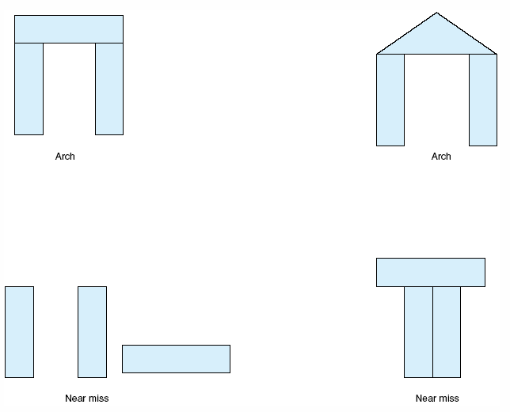
Examples and near misses for the concept “arch.”

Slide 6
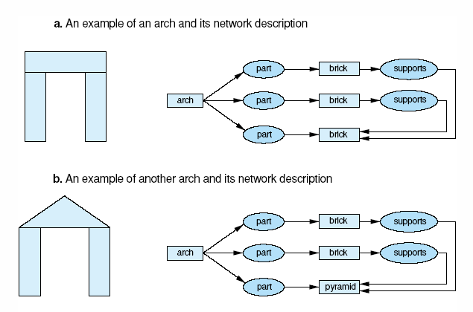
generalization of descriptions to include multiple examples.

Slide 7
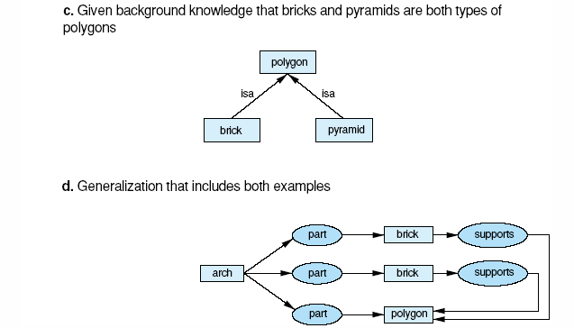
generalization of descriptions to include multiple examples (cont’d)

Slide 8
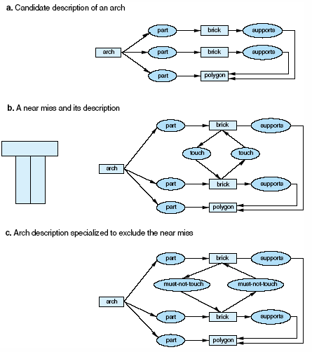
Specialization of a description to exclude a near miss. In (c) we add constraints to (a) so that it can’t match with (b).

Slide 9
The basic approach that the Winston's took to the problem of concept formation can be described as follows
Begin with a structural description of one known instance of the concept. Call that description the concept definition
Examine descriptions of other known instances of the concept.
Generalize the concept to include them
Generalize the concept hypothesis if the instance was a positive instance
Examine descriptions of near misses of the concept.
If incorrect then restrict the definition to exclude these.
identify the differences between the current example and the current concept;
Specialize the concept hypothesis if the instance was a negative instance.

Slide 10
A matching process was used to detect similarities and differences between structures.
One major problem of structural concept learning is that a teacher must guide the learning program through a carefully chosen sequence of examples.
The next section, Version Spaces , is a learning technique that is insensitive to the order in which examples are presented.

Slide 11
2. Version spaces
This describes another approach to concept learning.
Goal: to produce a description that is consistent with positive examples but no negative examples in the training set.
Winston’s system did this by a single concept description, version space work by maintaining a set of possible descriptions.
Consider an example representing an individual car using frame-based language:
car 023:
origin: Japan
manufacturer : Honda
color: Blue (Specific)
decade : 1970
type : Economy
Each slot may contain only discrete values as shown:

Slide 12
origin: {Japan, USA, Britain, Ittaly, Germany}
manufacturer : {Honda, Toyota, Ford, BMW, Fiat}
color: {Blue, Green, Red, White}
decade : {1970,1980,1990,2000}
type : {Economy, Luxury, Sports}
Concept description as well as the training examples, can be stated in terms of these slots and values.
For eg: “ Japanese economy car” can be represented as
origin: Japan
manufacturer : x1
color: x2 (General)
decade : x3
type : Economy
Some descriptions are more general than others. As shown in the partial ordering.

Slide 13
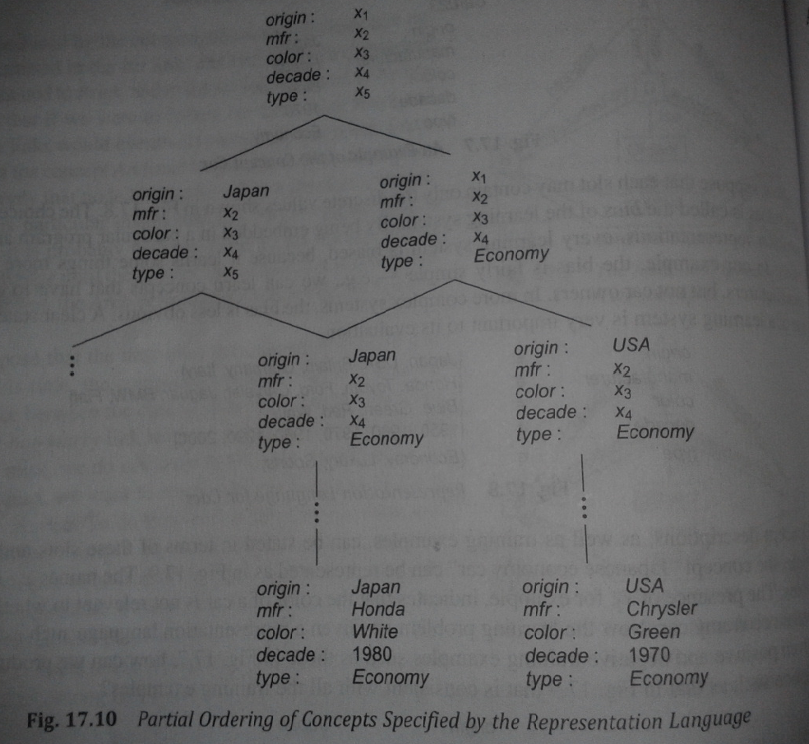

Slide 14
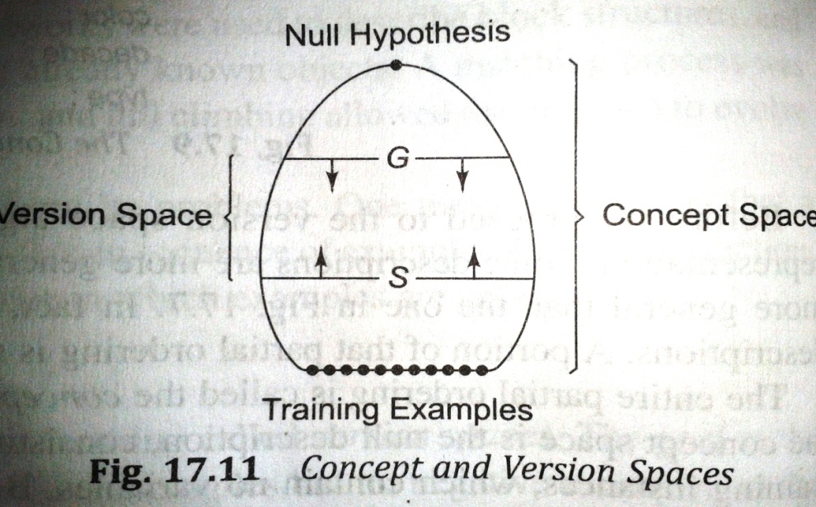
The entire partial ordering is called concept space. And can be depicted as follows.
At the top concept space is the null description , consisting only of variables.
Bottom represent all sets of training instances. which contains no variables.
Most target concepts lies somewhere in between these two extremes.
The version space is the largest collection of description that is consistent with all the training examples.

Slide 15
Version space consist of two subset of the concept space.
Subset G contains the General descriptions consistent with the training example.
Subset S contains the Specific descriptions consistent with the training example.
The version space is set of all descriptions that lie between some elements of G and some elements of S in concept space.
A positive training examples make S very general and a negative training examples make G very specific.
The candidate elimination algorithm helps to converge G and S and produce a single concept description

Slide 16
Algorithm: Candidate Elimination
Given: A representation language and a set of positive and negative examples expressed in that language.
Compute: A concept description that is consistent with all positive examples and none of the negative examples.
Initialize G to contain one element. The null description (all features are variables)
Initialize S to contain one element. The first positive example.
Accept a new training example.
If it is a positive example, first Remove from G any descriptions that do not cover the example. Then, update the S set to contain the most specific set of descriptions in the version space that cover the example and the current element of the S set. That is, generalize the elements of the set S.(ie. Generalize the element to cover the new training example)

Slide 17
If it is a negative example, first Remove from S any descriptions that cover the example. Then, update the G set to contain the most general set of descriptions in the version space that do not cover the example. Ie. Specialize the elements of G as little as possible so that the negative example is no longer covered by any of the elements of G.
4. If S and G are both singleton sets, then if they are identical, output their values and halt. If they are both singleton sets but they are different, then the training cases were inconsistant. Output this result and halt. Otherwise go to step 3
Note: Specialization means replaceing variables with constants.
Generalize means use variables instead of values
G must be specialized only to descriptions that are in version space, not outside of it.
positive example
G→ first Remove descriptions that do not cover the example.
S → Generalize the element to cover the new training example.
negative example
S → first Remove any descriptions that cover the example.
G → Specialize the elements of G so that they do not cover the negative example .

Slide 18
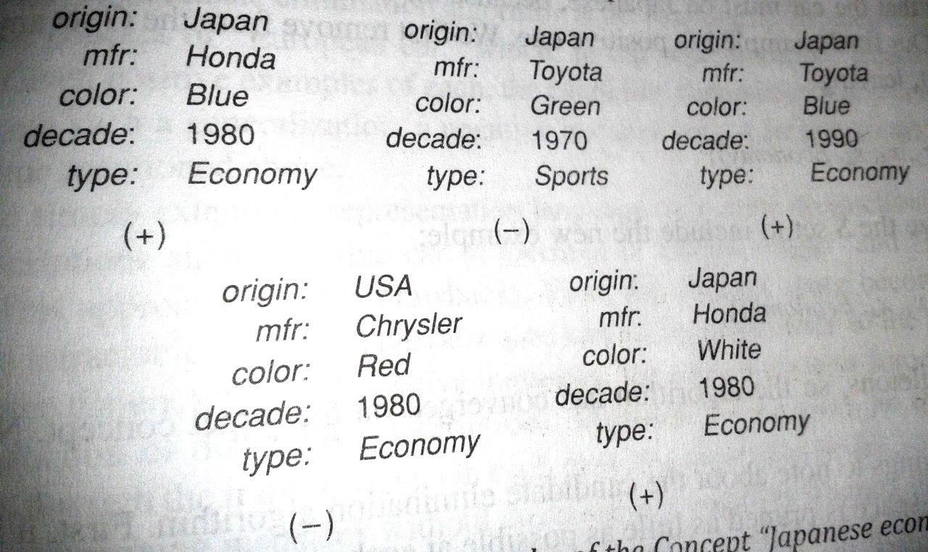
Trace the candidate elimination algorithm. With “Japanese economy car”. (+ve and –ve examples)

Slide 19
Candidate Elimination Algorithm : Iteration
G and S both start as singleton sets. G contains the null description and S contains the first positive training example.
G={(x1,x2,x3,x4,x5)} S={(Japan, Honda, Blue, 1980, Economy)}
Second example : -ve example
G={(x1,Honda,x3,x4,x5), (x1,x2,Blue,x4,x5), (x1,x2,x3,1980,x5), (x1,x2,x3,x4,Economy)}
S={(Japan, Honda, Blue, 1980, Economy)}
Third example : positive example
So remove any description that is inconsistent with new example from G.
Generalize S to include new example
G={(x1,x2,Blue,x4,x5), (x1,x2,x3,x4,Economy)}
S={(Japan, x2, Blue, x4, Economy)}
Fourth example : -ve example
G set must be specialized to avoid covering the new example.
G={(Japan,x2,Blue,x4,x5), (Japan,x2,x3,x4,Economy)}
S={(Japan, x2, Blue, x4, Economy)}

Slide 20
Fifth example : +ve example
G (Japan,x2,x3,x4,Economy)}
S={(Japan, x2, x3, x4, Economy)}
G and S are both singletons, so the algorithm has converged in the target concept. No more examples are needed to define the description.
“ Japanese economy car” can be represented as
origin: Japan
manufacturer : x2
color: x3
decade : x4
type : Economy

Slide 21
3. Decision Trees
Third approach to concept learning is the induction of decision trees.
Decision tress can be illustrate using ID3 algorithms.
Figure represents the concept “ Japanese economy car”
Origin?
USA -
Sports --
Economy +
Germany -
Britain -
Italy -
Japan +
Luxury --
Type?

Slide 22
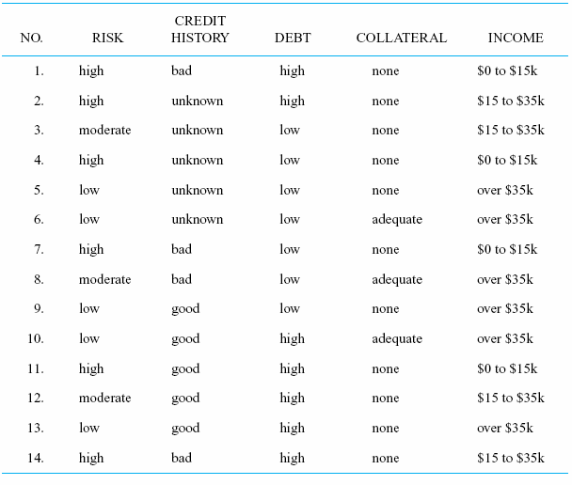
Consider the following table, which lists a sample of individuals with known credit risks.

Slide 23
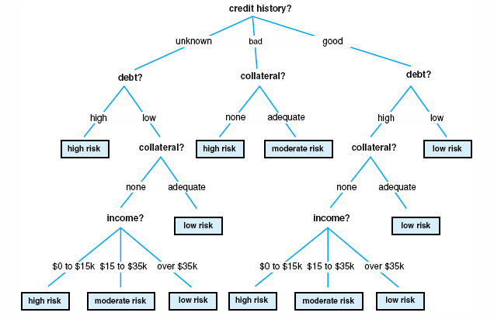
Decision tree

Slide 24
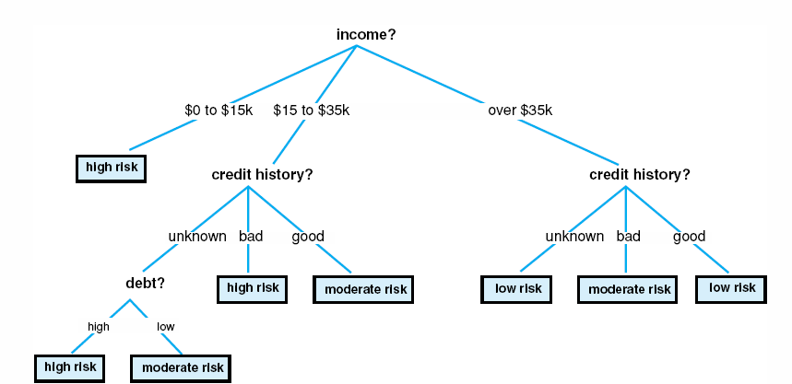
In a decision tree, Each internal node represents a test on some property, such as credit history or debt.
Each possible value of that property corresponds to a branch of the tree.
Leaf nodes represents the classification like moderate or high risk.
A new input may be classified by traversing this tree: at each internal node, test the value for that property, and take the appropriate branch. This continues until reaching a leaf node and the objects classification.

Slide 25
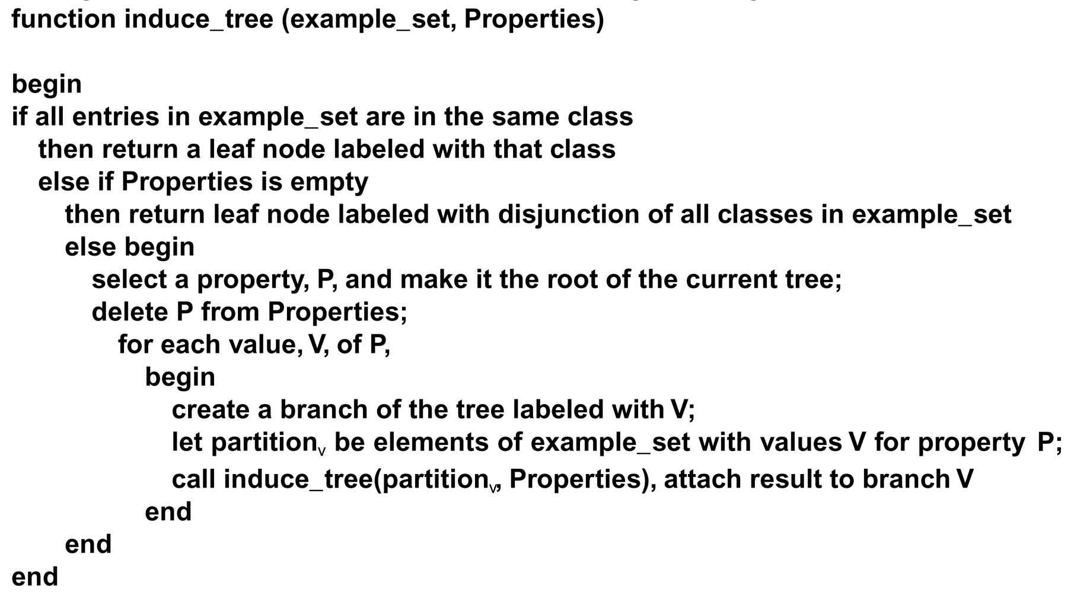
The induction algorithm begins with a sample of correctly classified members of the target categories. ID3 constructs a decision tree according to the algorithm: (Top-down decision tree Algorithm)

Slide 26
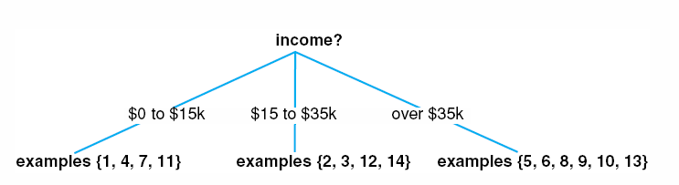
Beginning with full table of examples, ID3 selects income as root property. This partition the example set into 3 as shown in partially constructed decision tree.
ID3 applies induce_tree function recursively to each partition. For example partition {1,4,7,11} consists high_risk individuals. ID3 creates leaf node accordingly.
Then selects credit history as the root of the subtree for the partition {2,3,12,14} and creates four partitions. {2,3} {12} and {14}.
Continue the process and ID3 eventually produce the tree as shown in figures.

Slide 27
